Slide 1
Flow Rights Background
1928 Agreement
Established “authorized use” defined as the actual volume of flow in Millions of Gallons per Day (MGD) based on original investment
Discusses hearings for excessive use/sustained excessive use
No set dollar amount established for excessive use
1932 Agreement
Changed from total gallons per day used to “rates of flow” expressed in MGD
Establishes the term “however brief” into the contract language
Still set dollar amount established for excessive use

Slide 2
Flow Rights Background
1951 Agreement
Introduces excess rental charges for exceedances “any part of 10 separate days” <10 OK, 10th and after costs $
Rental Charge based on the Max exceedance x $5,000/MGD
1995 Agreement
Hearings to provide the towns the “the opportunity to provide evidence disputing the exceedance or the amount thereof.”
Rental Charge revised to be based on every exceedance, “including the exceedances during the parts of said first 10 separate days”
Financial penalty remains Max exceedance x $5,000/MGD

Slide 3
Flow Rights Background

Slide 4
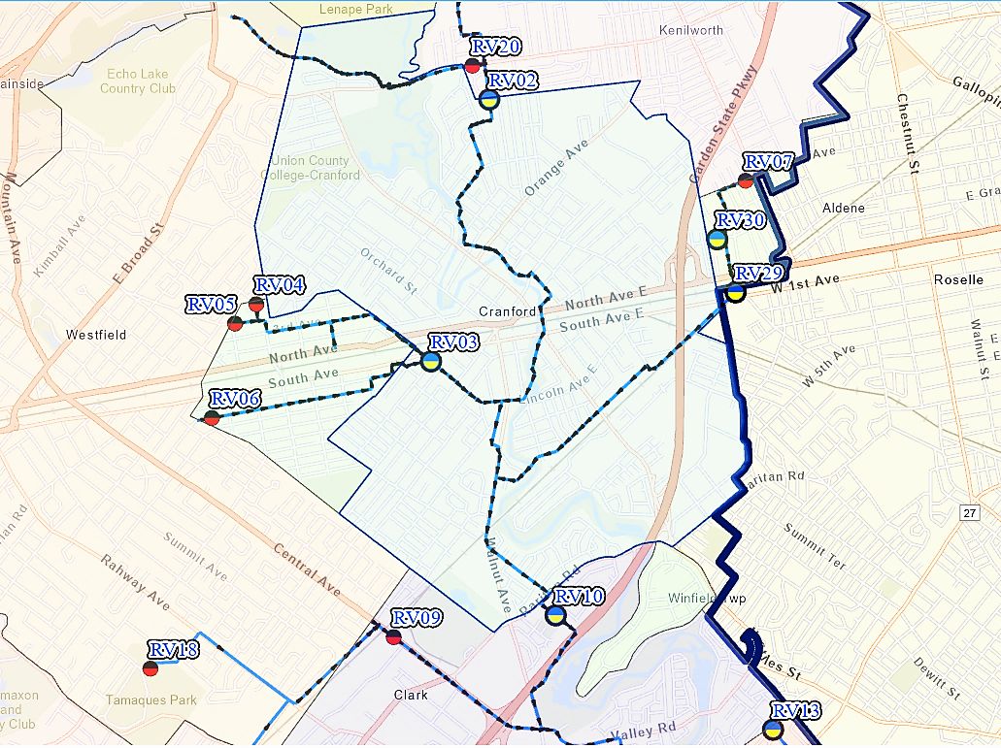
Metering

Slide 5
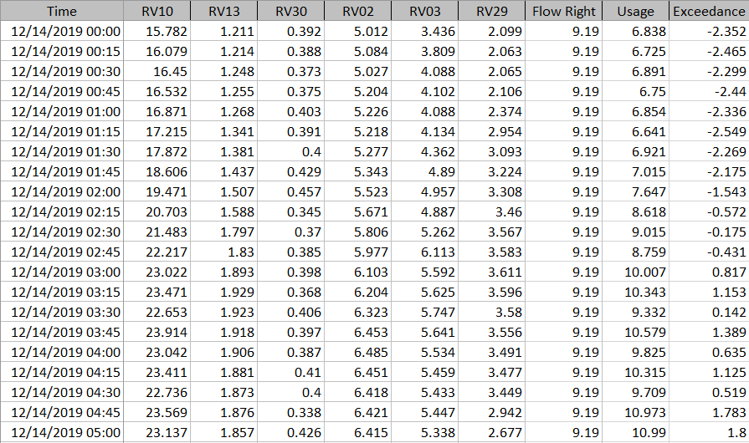
Metering

Slide 6
Metering

Slide 7
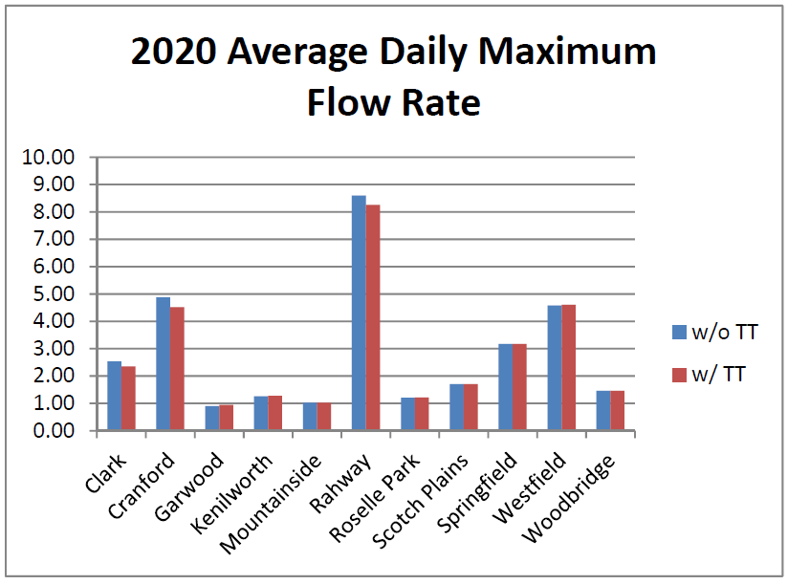
Time of Travel Impact

Slide 8
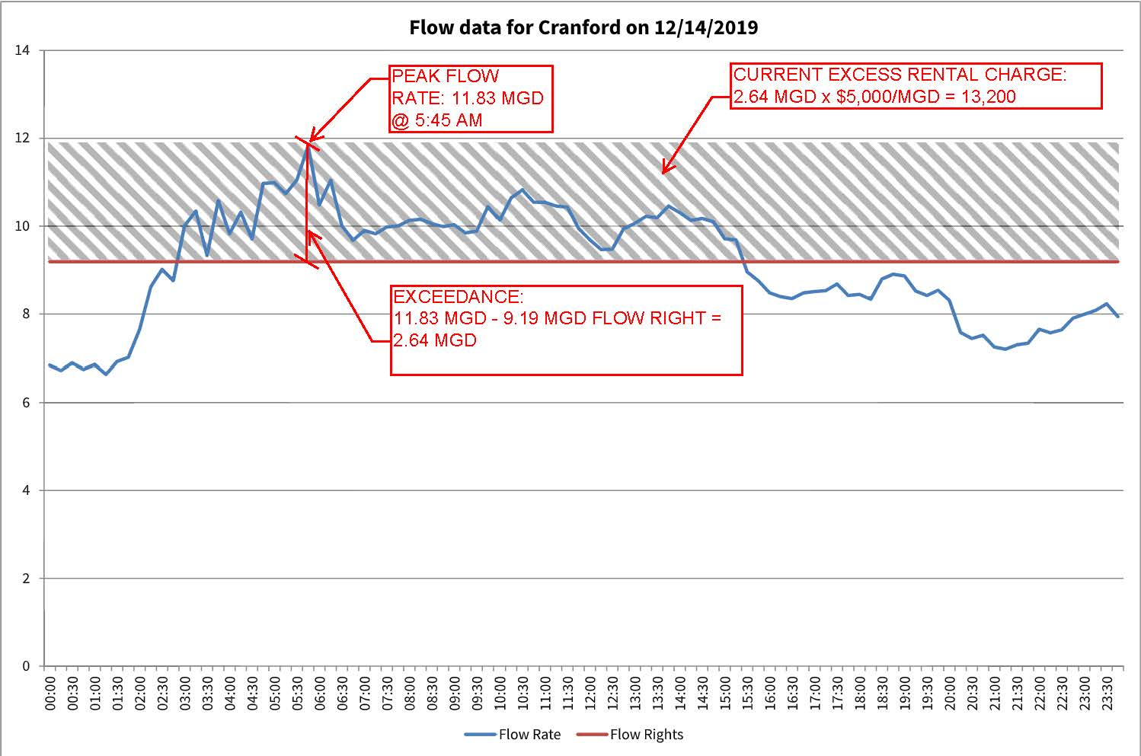
Excess Rental Charge
Currently no consideration for duration of event

Slide 9
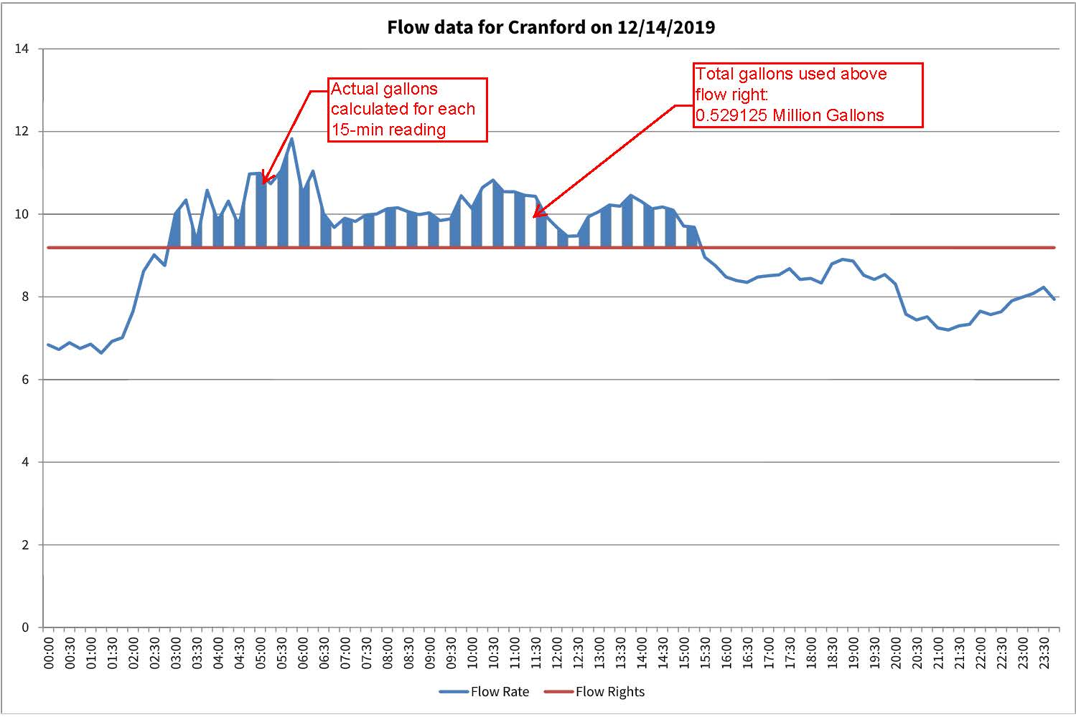
Excess Rental Charge
Propose to calculate the Rental Charge for Each 15-Min Reading
0.529125 MGD x $5,000/MGD = $2,646

Slide 10
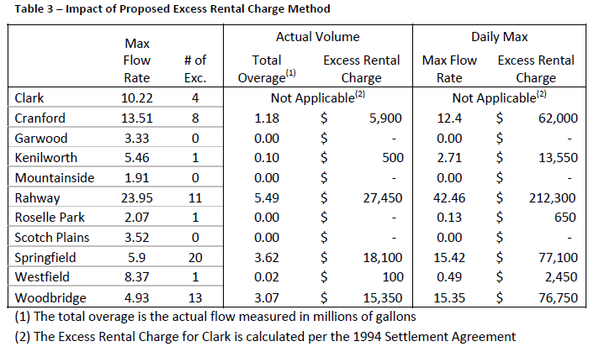
Excess Rental Charge
Propose to calculate the Rental Charge for Each 15-Min Reading

Slide 11
Questions?

